Slide 1



A guide to your removals service
Notes:
Hello and welcome to your guide on the removals service that will be provided to you for your temporary house move. This guide is to give a general outline on the service that we hope to provide. As soon as a removals company is appointed to the role additional information will be made available if necessary.

Slide 2
How long may it take to pack up your belongings?
The time it will take you to pack up your van will depend entirely on the size of your house and the number of belongings you are packing up.
On average, with the help of the removals experts, these are the times you would be looking at:
For a one-bedroom flat, you would be looking at around four to five hours. However, this may increase depending on how many belongings
For a two-bedroom house, we’d expect the packing and moving process to total around six to eight hours.
For a three-bedroom house, the average time that movers will take to complete the move from the house to a new property is around eight to nine hours.
For a house with four bedrooms or more, you could see the moving time taking longer than a day.
Notes:
The time it will take you to remove your belongings will depend entirely on the size of your house and the number of belongings you are packing up.
On average, with the help of the removals experts, these are the times you would be looking at:
For a one-bedroom flat, you would be looking at around four to five hours. However, this may increase depending on how many belongings you have to move.
For a two-bedroom house, we’d expect the packing and moving process to total around six to eight hours,
For a three-bedroom house, the average time that movers will take to complete the move from the house to a new property is around eight to nine hours.
For a house with four bedrooms or more, you could see the moving time taking longer than a day.

Slide 3


When will I get my supplies?
You will get your boxes and packing materials one month in advance of your moving date
Notes:
We would hope that your packing supplies can be delivered up to a month in advance however if households would prefer to have them closer to the moving date where possible this may be arranged.
It is essential to begin your decluttering and packing process as early as possible in order that you do not feel overwhelmed on the week of your house move.

Slide 4
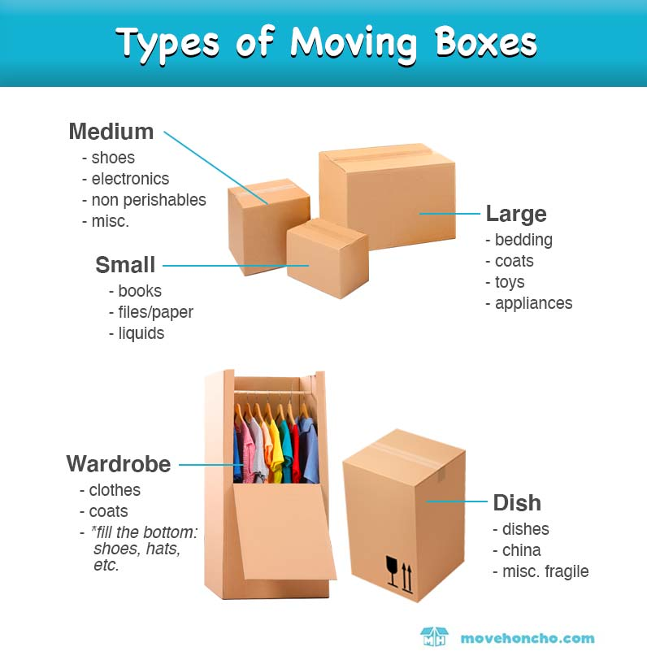
Packing Supplies
You will get a number of boxes suited to your family size and number of contents in your home.
Your removals company will be in direct contact with you to carry out a pre move survey and they will tell you how many boxes you will need.
You will receive wrapping paper and tape also
Notes:
Packing Supplies You will get a number of boxes suited to your family size and number of contents in your home.
Your removals company will be in direct contact with you to carry out a pre move survey and they will tell you how many boxes you will need.
You will receive wrapping paper, tape and other supplies as necessary

Slide 5

Your role in the removals…
Be present or represented during the collection and delivery of the removal
Ensure your beds are stripped of linen.
Ensure all of your belongings to be removed are packed appropriately, labelled and ready for your assigned collection time.
Declare, in writing, to the removals company the value of the goods being removed and/or stored.
Ensure authorized signature on agreed inventories etc, by way of confirmation of collection or delivery of goods.
Notes:
Your role in the removals is vital if the process is to go smoothly
Please be present or represented during the collection and delivery of the removal. You will be given a time for removals by your removal service and you will need to be available and ready at this time.
Ensure your beds are stripped of linen and that this is packed away and ready for removals. Please do not disassemble any of your furniture yourself. Your removers will do this for you. Should your furniture be disassembled, your removals company will not be in a position to reassemble this item for insurance purposes.
Ensure all of your belongings to be removed are packed appropriately, labelled and ready for your assigned collection time.
Declare, in writing, to the removals company the value of the goods being removed and/or stored.
Ensure you give an authorized signature on agreed inventories, receipts, or other relevant documents by way of confirmation of collection or delivery of goods.

Slide 6
Your role in the removals….
Take all reasonable steps to ensure that nothing that should be removed is left behind and nothing is taken away in error.
Arrange proper protection for goods left in unoccupied or unattended premises, or where other people such as tenants or workmen are, or will be present.
Stabilize all appliances or electronic equipment prior to their removal.
Empty, properly defrost and clean refrigerators and deep freezers.
Galway City Council will not be liable for any loss or damage, costs or additional charges that may arise from failure to meet these responsibilities.
Notes:
Please take all reasonable steps to ensure that nothing that should be removed from your home is left behind and that nothing is taken away in error.
Arrange for the proper protection for goods left in unoccupied or unattended premises, or where other people such as (but not limited to) tenants or workmen are, or will be present.
Take care to stabilize all appliances or electronic equipment prior to their removal.
Please empty, properly defrost and clean refrigerators and deep freezers.
Galway City Council will not be liable for any loss or damage, costs or additional charges that may arise from failure to meet these responsibilities.

Slide 7
Goods not to be submitted for removal or storage
The following items will under no circumstances be moved or stored:
Prohibited or stolen goods, drugs, pornographic material, potentially dangerous, damaging or explosive items, including gas bottles, aerosols, paints, firearms and ammunition.
Jewellery, watches, precious stones or metals, money, deeds, securities, stamps, coins, or goods or collections of any similar kind.
Plants or goods likely to encourage vermin or other pests or to cause infestation or contamination.
Perishable items and/or those requiring a controlled environment.
Any animals, birds or fish.
Goods which require special licence or government permission for export or import.
If you submit such goods without our knowledge we will make them available for your collection
Notes:
Certain Goods are not to be submitted for removal or storage and will under no circumstances be moved or stored:
Prohibited or stolen goods, drugs, pornographic material, potentially dangerous, damaging or explosive items, including gas bottles, aerosols, paints, firearms and ammunition.
Jewellery, watches, precious stones or metals, money, deeds, securities, stamps, coins, or goods or collections of any similar kind.
Plants or goods likely to encourage vermin or other pests or to cause infestation or contamination.
Perishable items and/or those requiring a controlled environment.
Any animals, birds or fish.
Goods which require special licence or government permission for export or import.
If you submit such goods without our knowledge we will make them available for your collection

Slide 8
Items that are not covered under insurance for removals
Bonds, Securities, Stamps of all kinds, Manuscripts or other Documents or Electronically held Data Records, Mobile Telephones
Plants or goods likely to encourage vermin or other pests or tocause infestation or contamination.
Perishable items and/or those requiring a controlled environment.
Furs exceeding €100 in value, Jewellery, Watches, Precious Stones and Metals, Money, Coins, Deeds.
Any animals, birds or fish.
Notes:
Certain items are not usually covered under insurance for removals. Where necessary please make arrangements to transport these items yourself for safety
The following I a list of items that we will not be in a position to have removed for you.
Bonds, Securities, Stamps of all kinds, Manuscripts or other Documents or Electronically held Data Records, MobileTelephones
Plants or goods that are likely to encourage vermin or other pests or to cause infestation or contamination.
Perishable items and/or those requiring a controlled environment.
Furs exceeding €100 in value, Jewellery, Watches, Precious Stones and Metals, Money, Coins and Deeds.
Any animals, birds or fish.

Slide 9
Events the removals company are not insured against
By war, invasion, acts of foreign enemies, hostilities, civil war, terrorism, rebellion and/paramilitary coup, Act of God, industrial action or other such events outside our reasonable control.
Loss or damage arising from ionising radiations or radioactive contamination
Loss or damage arising from Chemical, Biological, Bio-chemical, Electromagnetic Weapons and Cyber Attack
Indirect or consequential loss of any kind or description
By normal wear and tear, natural or gradual deterioration, leakage or evaporation or from perishable or unstable goods. This includes goods left within furniture or appliances.
By vermin, moth, insects and similar infestation, damp, mould,mildew or rust
Notes:
There are a number of Events the removals company are not usually insured against. For your information the list is follows;
By war, invasion, acts of foreign enemies, hostilities (whether war is declared or not), civil war, terrorism, rebellion and/paramilitary coup, Act of God, industrial action or other such events outside our reasonable control.
Loss or damage arising from ionising radiations or radioactive contamination
Loss or damage arising from Chemical, Biological, Bio-chemical, Electromagnetic Weapons and Cyber Attack
Indirect or consequential loss of any kind or description
By normal wear and tear, natural or gradual deterioration, leakage or evaporation or from perishable or unstable goods. This includes goods left within furniture or appliances.
By vermin, moth, insects and similar infestation, damp, mould,mildew or rust

Slide 10
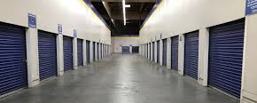
What will need to go to Storage…
Your white goods apart from fridge will go to a professional storage company. Your window dressings such as blinds will also need to be stored and any freestanding wardrobes unless there is room in your temporary accommodation for the items.
Notes:
The temporary accommodation will be part furnished for you . This means that some of the white goods from your kitchen will need to be put in storage, along with your window dressings and also any freestanding wardrobe units that you own.
Where there are spare bedrooms in the temporary accommodation ,these can be used to store items not in use for the duration of the temporary transfer.

