Slide 1




Moving House
A guide to organising your House Move
Notes:
Hello and welcome. This presentation will explore moving house and offer guidance on how to prepare for and mange your short term house move.

Slide 2
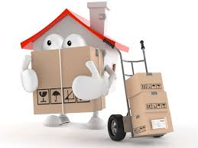
Contents
Preparation
Decluttering
Waste Management
4. Brief overview
Notes:
We will cover topics around how to prepare for your short-term house move, such as how to organise decluttering your home and how to manage your waste.
It is designed to be a supportive guide and we encourage you to use what you find helpful.

Slide 3

If you don’t need it...don’t move with it!
You have enough possessions to box up without dealing with unused and unnecessary items you no longer need.
Notes:
Preparation is key when it comes to organising yourself for a house move. Start as early as you can in organising your possessions. If you don’t need it...don’t move with it! You have enough possessions to box up without dealing with unused and unnecessary items that you no longer need. It is important not to bring any new items into your home until the decluttering process is complete, so please try to be aware of impulse buying.

Slide 4


Clear outs are not just for spring!
“If your stuff isn’t serving you, it won’t be serving you any better packed away in a box somewhere”
- Melissa Camara Wilkins
Notes:
Start with small decluttering projects that feel big. Before you commit to an entire room, start with a few small projects that will give you a sense of accomplishment when you’re done.

Slide 5
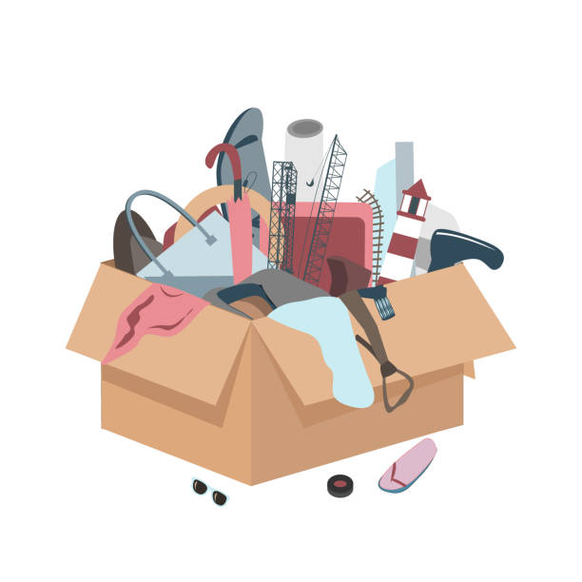
What Should I do with this ?
There are numerous ways to make the decision on how to begin decluttering
Notes:
There are numerous ways to make the decision on how to begin decluttering
Get mentally prepared for your house move. Remind yourself of the benefits of beginning early.
Gather all the materials you'll need such as boxes and labels.
Tackle one item or one small area at a time
Ask yourself the right questions. Remember you can ask for help at any time. If you are finding this an overwhelming task, please contact your resettlement officer as early as possible who will put extra supports in place to help you.

Slide 6

How to Clear Clutter…
DOES IT HAVE VALUE?
DO YOU NEED IT? CAN IT BE RECYCLED?
YES NO yes NO
Keep It Bin It
Sell or Donate it RECYCLE
yes
No
Notes:
You can use this flowchart to help you to decide on what you want to hold onto. Decide what area or item you want to declutter and begin with asking yourself does it have Value to me? Do I need it? Follow the questions in the flow chart to begin to divide your belongings into what you wan to keep and what you wish to rehome.

Slide 7
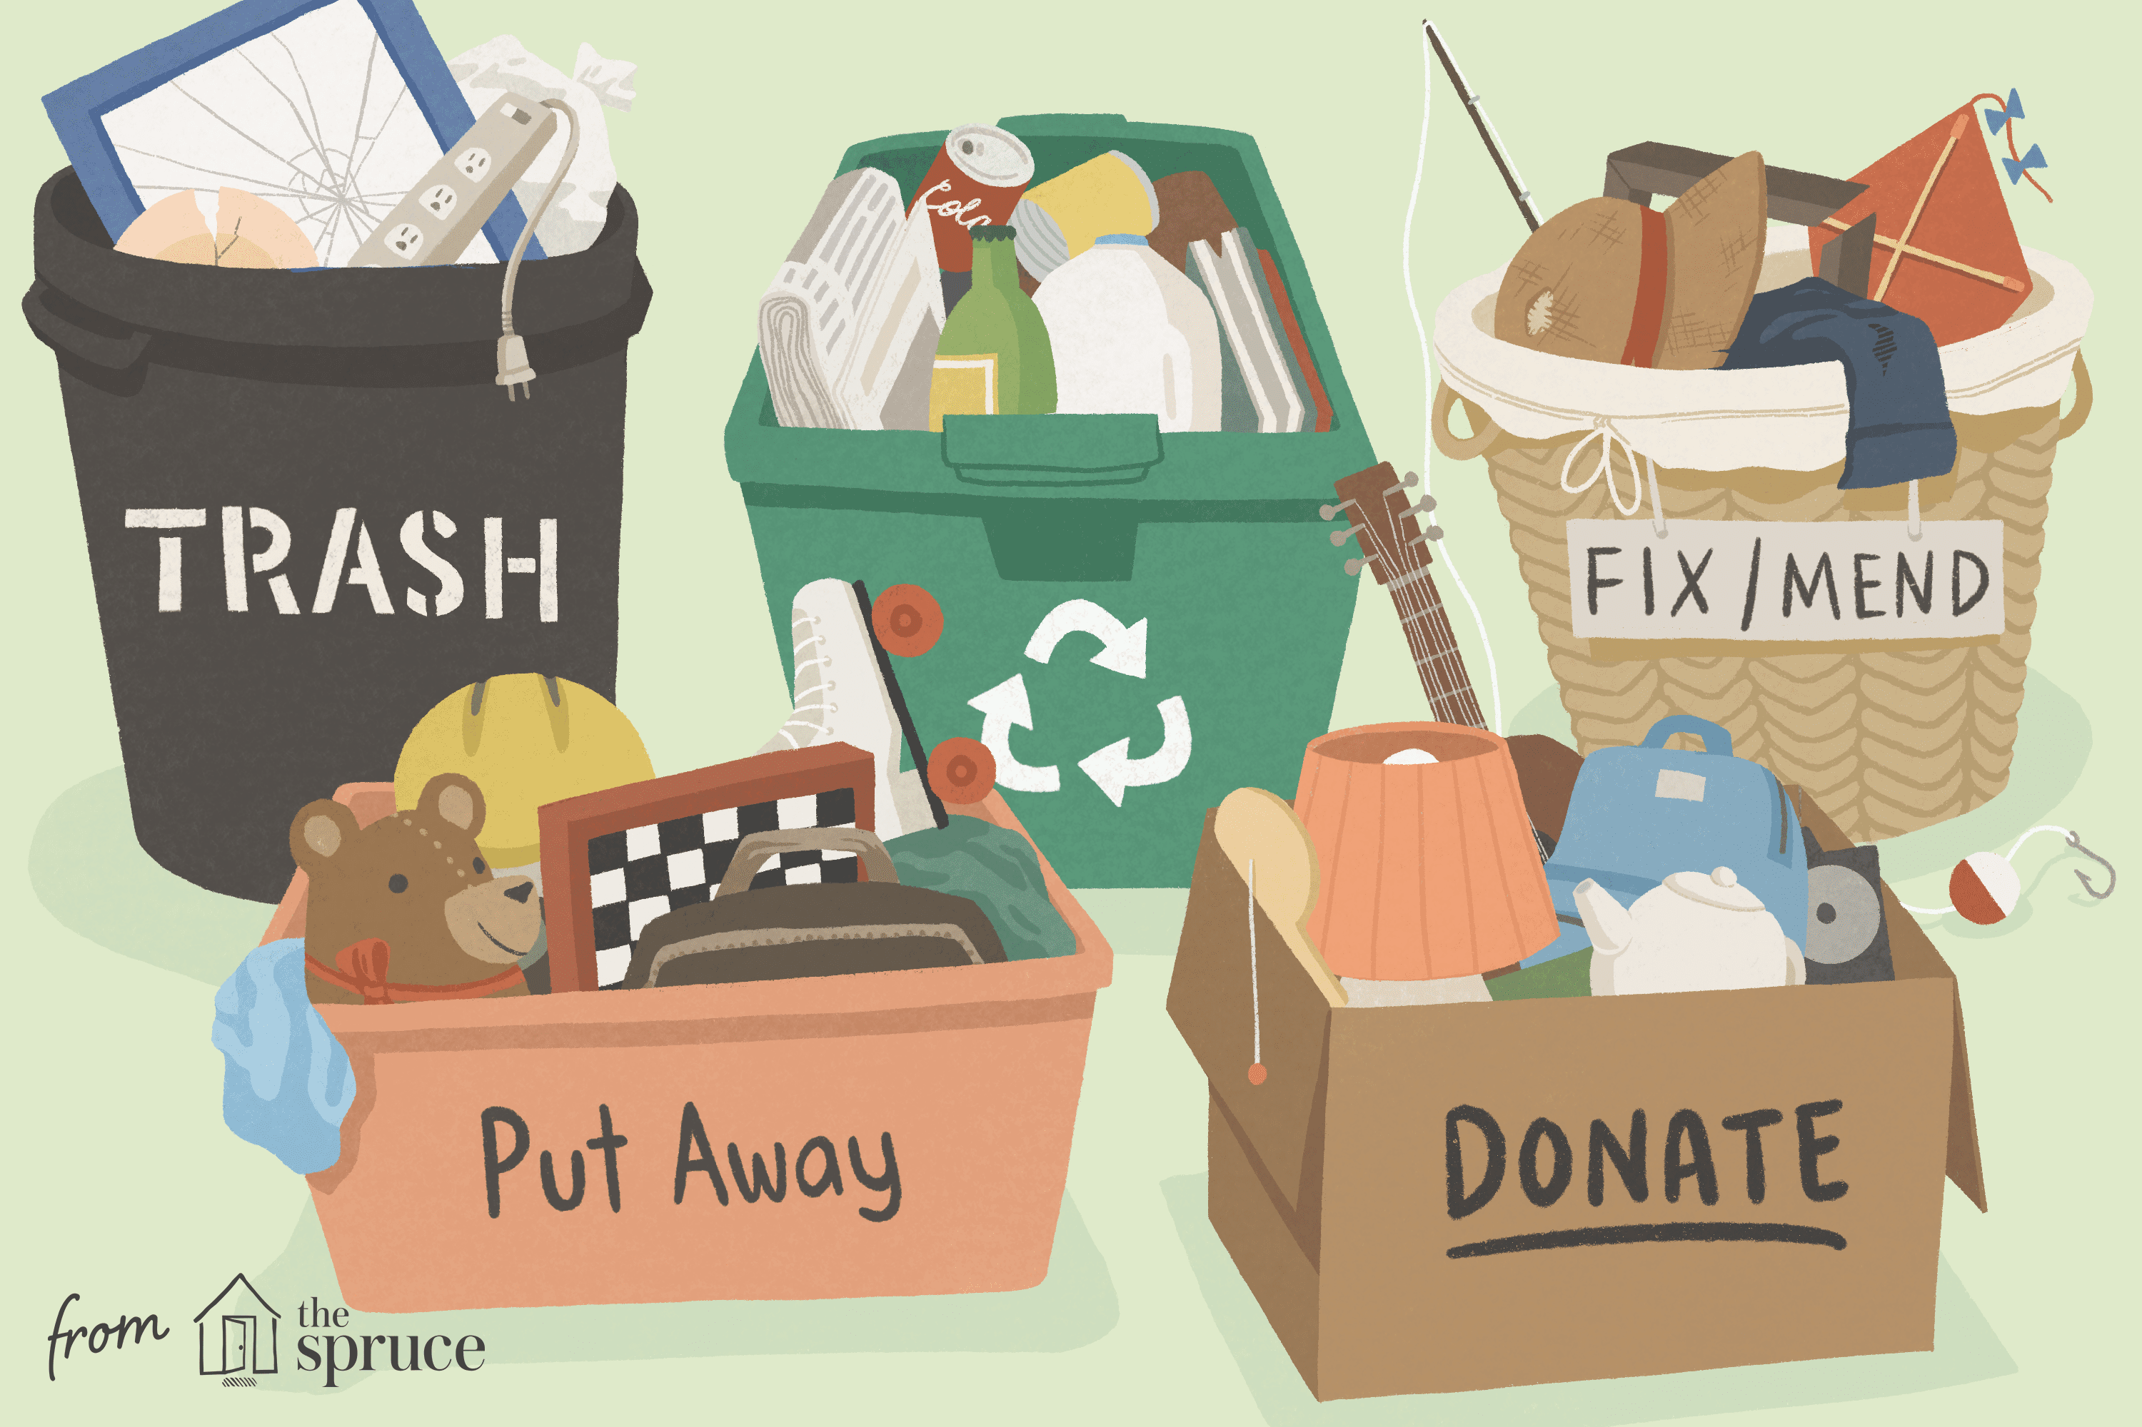
The Big Clear Out
Reducing the amount of belongings you have in this manner will save you countless hours and space later on in the packing and moving process.
The only way to tackle this is head on
Notes:
How to manage the big clear out; The only way to tackle this is head on. Here are a few tips which may help you to begin the process;
1.The 80/20 rule: When it comes to clothing, we generally only wear 20 percent of the clothes we own 80 percent of the time. This rule tends to hold true for other things as well, such as video games, computer parts, books, DVDs, toys and more. Your mission is to get rid of the things you don’t use 80 percent of the time.
2. Get over sunk costs. In the world of economics, costs that have already been incurred and cannot be recovered are referred to as sunk costs. As you go through the items in your house, most things should be considered sunk costs (except for rare situations where an item may have increased in value). Since you cannot get the money back that you spent on that item, you should only think about the value that thing can add to your life in the future. Understanding this concept of sunk costs can help you make more rational decisions about what to keep and what you should toss.
3. See if it works. If whatever treasure you found stashed away in your house doesn’t work, get rid of it. If you want to fix it, then fix it, but don’t let it sit in your house for another month collecting dust.
4. Think of the last time you used it. If you haven’t used something you have come across whilst decluttering in the last six months, you should probably get rid of it. If you pulled the item out and said, “I’ve been wondering where this was!" you should probably get rid of it. And if you didn’t even know you still had the item in question, you should definitely get rid of it –you didn’t miss it enough to warrant keeping it.
5. Track which items you actually use. A tip you can use with clothing, books and DVDs is over the course of the next six months, when you use or wear an item put it back facing the opposite direction of the others. This allows you to see what you’ve used and what you haven’t. If you haven’t used or worn something in a year, get rid of it.
6. Ask yourself if you love it. This may seem obvious, but sometimes we keep things we aren’t completely crazy about. Yes, sometimes we spend money on things we don’t love, and sometimes we don’t return them. But if you don’t love it, and you haven’t used it in more than 6 months, add it to the “Get Rid of It" bin.

Slide 8
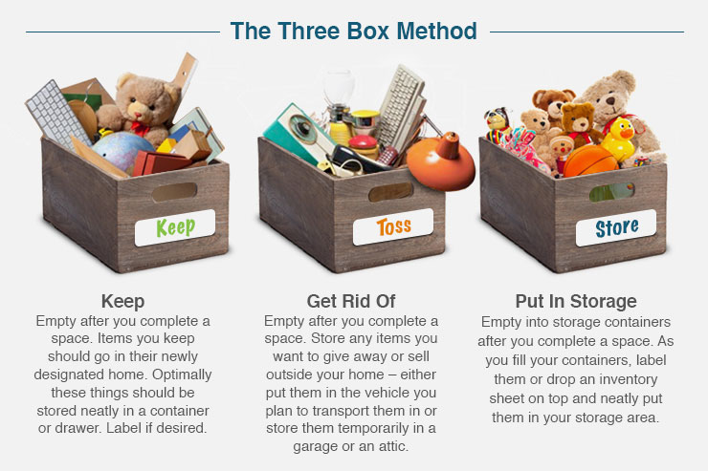
Decluttering
Gather three boxes or storage bins, label them as per the method shown and then use the organising tips to the right
You can follow the declutter challenge below if you want to make the activity more fun and involve all the family
Notes:
There are a number of different methods of decluttering.
It could be useful to begin with mapping your spaces and grade them on the severity of the clutter.For example, on a scale of 1 – 3 (3 being the most cluttered) a particularly messy room or closet would get a 3. This will help you prioritise your time.
Begin with a small project and it will help you to get used to decluttering and also lead to less overwhelm at the overall task.
A useful method of decluttering is to gather three boxes or storage bins, label them as per the method shown and then use the organising tips to the right.
If you are unsure about your choices you can Sleep on it. After you’ve made the decision to get rid of some of the clutter in your home, sleep on it. If there’s something you can’t live without, you’ll know in the morning. You can pull it out of the junk bin and put it away
Some simple tips are to Keep like things together. Categorizing things as you go through them is imperative to organising your home. In fact, keeping like things together forces you to organize your home. And it will make your life easier! Store like items close to where you will use them and you’ll not only know where they are when you need them, but you’ll reduce some of the little frustrations in your daily life.
. Clear off flat surfaces. Countertops, shelves and other flat surfaces are clutter-magnets. If you need to keep a few things on the countertops, that’s OK, but make it a goal to free your flat surfaces of most clutter. Make space in drawers or add small boxes or bins to your shelves for paper items. Only keep frequently used, essential small appliances on kitchen countertops – the rest should be put away or donated if you never really use them.

Slide 9

Use 8 weeks prior to your house move and follow the daily guide to help you prepare for your move
30 day Declutter Guide-
Clean out and Organise three kitchen cabinets | Clean out refrigerator | Clean out freezer | Organise spices and throw out old ones | Clear out one junk drawer | Clear out food presses
Clear out wallet and purse | Clear out makeup/ toiletries section | Clear out and Organise three kitchen cabinets | Shed clear out- identify unwanted /broken/ out of date items | Clear out bathroom cabinets | Clear out medicine cabinets
Organise your cleaning supplies | Clear out kids closets and donate clothes | Clear out kids drawers and donate clothes | Clear out kids toy area and donate | Clear out and Organise three more kitchen cabinets | Clear out and Organise bedside tables and dresser top
Clear out all books dvds and other media and donate | Clear out one more junk drawer | Clear out all old papers and mail | Clear out adult closets and donate | Clear out adult drawers and donate | Clear out old shoes/ runners
Clear out all accessories bags, hats and scarfs and donate | Clear out the office area | Clear out shed: dispose of any toxic chemicals appropriately. Have large items collected | Clear out Linen closet | Clear out laundry room and ironing basket | Clear out glass wear/ artwork/ pictures and donate
Notes:
By using a 30 day challenge such as this example you are taking a piecemeal approach . This means that going day-by-day you can break down what is a large job into manageable portions. It includes a small task to do every day, and at the end of the month, you and your home will emerge with a totally clean slate. There are a number of 30 day challenge apps that you can get for both Android and iphones which will help to keep you on track.

Slide 10


Share the work!
The best way to find out what you really need is to get rid of what you don’t
- Marie Kondo
The best way to find out what we really need is to get rid of what we don’t
- Marie Kondo
This is a task for everyone who lives in your home. It is a good idea if everyone who can, takes a role in decluttering their own belongings.
Notes:
It is important if you live with people to share the work.
This is a task for everyone who lives in your home. It is a good idea if everyone who can, takes a role in decluttering their own belongings
The following are tips for getting your loved ones on board to help you with this task;
Be the example
Give them the tools they need to declutter
Plan a scheduled declutter day
Plan ahead in advance and give plenty of notice
Make it fun- Give a reward for helping
Donate regularly

Slide 11

Waste Management: Options for disposing of the “Get Rid of It" box.
Recycle: Recyclable, plastics and paper can go straight into your recycling bin. Otherwise put your recyclables in bags so you can transport the waste to the nearest recycling drop off location. Glass must be disposed of at the nearest bottle bank
Galway City council offer a bulky goods collection service (subject to Covid 19 restrictions). It is intended for households who wish to dispose of household items such as furniture or large electrical items.
You can contact Galway City Council on 091-536400 to arrange collection of your item which is to be left on the kerbside as close as is possible to the front access gate by 8am on the morning of the allocated collection date.
Notes:
When it comes to managing the waste from your declutter you can Recycle: Recyclable, plastics and paper can go straight into your recycling bin. Otherwise put your recyclables in bags so you can transport the waste to the nearest recycling drop off location. Glass must be disposed of at the nearest bottle bank
Further information is available at www.galwaycity.ie/bring-banks
Galway City Council offers a bulky goods collection service. Further information is available at www.galwaycity.ie/bulky-goods-collection-2
If you use the services of a private waste collector ensure they hold a valid waste collection permit. Note: Charges apply for this service

Slide 12
Waste Management
Donate or Freecycle: Clothes, shoes and other household items in good condition can be donated to a number of local charities. Your closest Charity shops include:
St Vincent de Paul Mervue.
Age action, Francis St, Galway.
Cope Galway St, Augustine St, Galway.
The Simon Shop, Sea Rd.
Never too old Furniture Charity Shop Claregalway.
Join a Car boot Sale Event: If you’re up to the task, you may be able to make a little money off unwanted items by joining a car boot sale. Just make sure you begin your declutter process early enough so you can participate
Local car boot sales: Kilchreest Car Boot Sale – 2nd Sunday of month, 10am-3pm.
Located in Kilchreest Village Near Loughrea on the (N66) (subject to Covid 19 restrictions).
Notes:
\In order to manage waste from your decluttering you might possibly Donate or Freecycle:
Clothes, shoes and other household items in good condition can be donated to a number of local charities.
A list of Your closest Charity shops include:
St Vincent de Paul Mervue.
Age action, Francis St, Galway.
Cope Galway ,St. Augustine st, Galway.
The Simon Shop, Sea Rd.
Never too old Furniture Charity Shop Claregalway.
You ma prefer to Join a Car boot Sale Event: If you’re up to the task, you may be able to make a little money off unwanted items by joining a car boot sale. Just make sure you begin your declutter process early enough so you can participate
There is a Local car boot sales in Kilchreest Car Boot Sale on the 2nd Sunday of the month, normally from 10am-3pm.
Kilchreest Village is located Near Loughrea on the (N66) (This is subject to Covid 19 restrictions).

Slide 13
Where can I bring my unwanted waste?
Large recyclable plastic/metal/timber items, used cooking and engine oil, waste electrical items and batteries are just some of the items that are accepted at the Galway City Council Recycling Centre at Liosban Industrial Estate.
Further information is available at:
http://www.galwaycity.ie/environment-litter-waste/recycling-centre-2
For other waste services please contact:
sales@BarnaRecycling.com or www.barnarecycling.com 091 771619
home@citybin.com or www.citybin.com 091 787800
Notes:
You can bring your unwanted waste to a number of different facilities. Large recyclable plastic/metal/timber items, used cooking and engine oil, waste electrical items and batteries are just some of the items that are accepted at the Galway City Council Recycling Centre at Liosban Industrial Estate. Further information is available at the mail address given here. http://www.galwaycity.ie/environment-litter-waste/recycling-centre-2
Barna Recycling service is based in Carrowbrowne, Headford Road, Co. Galway - 091 771619, and
The City Bin Company, is based in Oranmore, Co. Galway - 091 787800,
Please contact them directly via the websites or numbers given here for further information on the services they provide.

Slide 14
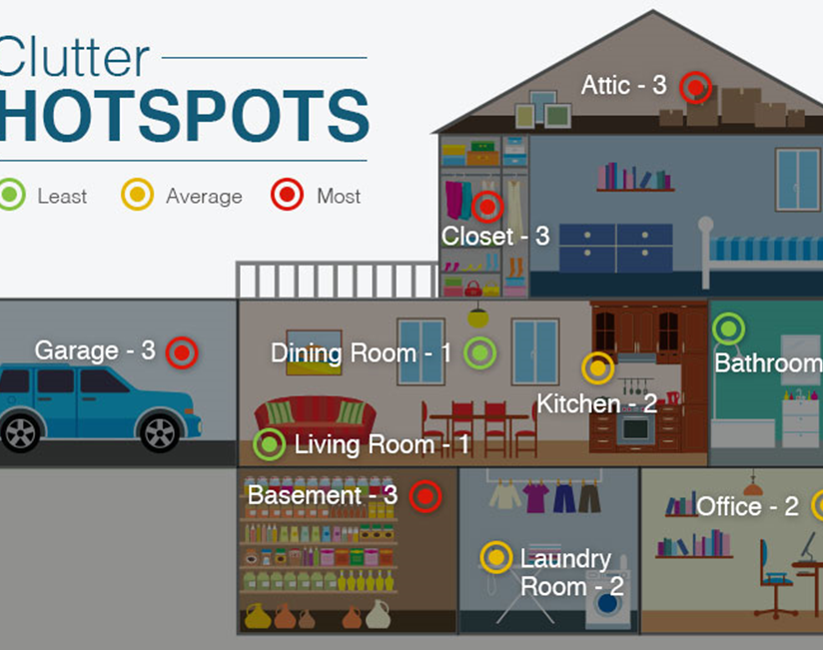
A quick overview
Make a map of all the rooms and ‘clutter hot spots’ you want to tackle.
Set completion dates for each phase of your clean up.
you should also plan time to work on specific areas when you expect decluttering those spaces to take longer than a few hours, such as shed or garage
Do one room or one space at a time.Begin decluttering well in advance.
Notes:
So to quickly sum up what we have covered;
Make a map of all the rooms and ‘clutter hot spots’ you want to tackle. Give each space a grade based on the severity of the clutter.
Set completion dates for each phase of your clean up. Be sure to pick dates that are attainable so you don’t get frustrated. If you make it into a declutter challenge for yourself this may help.
you should also plan time to work on specific areas when you expect decluttering those spaces to take longer than a few hours, such as shed or garage
Do one room or one space at a time.Begin decluttering well in advance. The average time it takes to declutter all of your items depends mainly on their number. However, in general packing tip is that you should start the process earlier than most people think. For a large house, two months should be enough. For smaller homes, one month should be just fine

Slide 15


Finally…
Try not to put this task off for too long . Your aim is to make this process as easy as you can and this will help you to organise what is to be packed.
You will be returning to a fully refurbished house that you will be able to settle into with no clutter.
Notes:
And Finally; Try not to put this task off for too long . Your aim is to make this process as easy as you can and this will help you to organise what is to be packed.
Time and Patience is important. Decluttering is a tall task so go easy on yourself!
You will be returning to a fully refurbished house that you will be able to settle into with no clutter.

